Slide 1
Think Globally. Report Locally.
Technology-enabled Global Harmonization of Safety
Reporting using Local Laws
Notes:
Go straight to Slide 4

Slide 2


Today’s Speaker
Speaker
Steven Beales
Senior Vice President, IT
Market Owner, Safety Solutions

Slide 3
The views and opinions expressed in this presentation and any related discussion(s) are solely those of the individual presenter(s) and do not express the views of and opinions of Roche or WCG.

Slide 4



What are we going to learn today?
Lack of Global Harmonization in Reporting Rules is Drug Safety’s No. 1 Challenge *
Roche has solved it ⁺
+ 97% solved based on individual Site and IEC rule exceptions
* Clinical Trials 2017, Vol 14
Notes:
Introduction
My father has Parkinson’s disease. 5 years ago, he experienced Parkinson’s psychosis. He believed that people were trying to break into his house . No drug is approved in UK to treat Parkinson’s psychosis. Fortunately, my father’s symptoms remitted with standard of care and he is now doing well. Except for a resting tremor, you would not know he is ill. In the US, there is a drug approved to treat Parkinson’s psychosis. You may have read the headlines yesterday that this drug has been linked to 100s of deaths since its approval. I don’t know enough about the efficacy and safety of this drug to know if it should remain on market. I know I am grateful that I never had to decide whether or not to give this drug to my father. I would like to thank all the people in this room who work tirelessly every day to keep patients safe even in face of tremendous commercial pressures.
Statistically, 2 people at this conference will be hospitalized this year with a serious adverse event.
Given this statistic, most of you will be thinking, how can you say that Lack of Global Harmonization in Reporting Rules is Drug Safety’s No. 1 Challenge? It’s not me saying that. It’s you. That statement comes from the 2015 CTTI survey of Drug Safety and Clinical Operations executives. Today, we’re going to look at the downstream problems that have their root cause in lack of Global Harmonization.
2nd thing we’re going to learn is that with few exceptions Roche has solved this challenge of harmonizing global reporting rules.

Slide 5

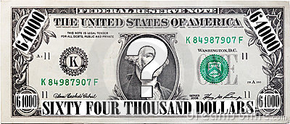
Why is it important to learn this now?
Increases site burden
80% Sites receive > 20 Safety Reports per Month
14% SUSARs met criteria FDA Study Audit
Increases compliance risk
$2m for Safety Reporting
1 Roche Study
Increases cost
Notes:
Why is this Global disharmony in Safety Reporting the root cause of so many downstream issues?
1) Our sites are over-burdened. 80% sites get more than 20 SUSARs monthly. At least half of those SUSARs are not required. It takes an average of 2 hours to process each SUSAR, taking time away from patients.
2) It increases compliance risk. All these SUSARs have to be tracked by monitors to ensure they were delivered. In 1 FDA audit of an Oncology trial, only 14% of SUSARs were informative and necessary.
3) Each SUSAR costs $3-11 to deliver on average. 15$-25$ for monitoring. $50-75$ to the site to process. Roche on 1 study spent $2m on Safety Reporting. Study Teams don’t know how much they should be paying for SUSAR distribution.

Slide 6
Why Listen to Me?
Have worked with Roche for 9 years building solutions to this Global problem
In March 2017, we launched
Clinical Trial Safety Portal 2.0 (CTSP)
Notes:
I came from England to US 20 years ago – although my accent got stuck in middle of Atlantic. I’ve been fortunate to work with some of you and build Clinical Trial systems at 4 of top 5 pharmas, 4 of top 5 biotechs, and 3 of top 5 academic medical centers.
In 2009, Genentech asked me to build their Clinical Trial Portal for all their investigators and ethics committees, which Roche launched in August 2011. We predicted 600k SUSAR notifications in that first year. I remember the day we switched the system on vividly and the dread whether the system would function as designed worldwide. It took about a month for me to relax and accept the system was working as intended. It has since grown into the largest safety reporting system in the world. In 2017, we are distributing 60K notifications every single day to 78k active users in 107 countries. Safety reporting has become my passion.
In 2015 Roche asked us to enhance the portal with regulatory intelligence from all countries worldwide and to make the system configurable by end users. This was 1 of those high-profile projects where you start it off not knowing how you’re going to achieve the goal and by working with brilliant people from all areas of business, you become successful. In March 2017, we launched that system.

Slide 7
Our results after 1 year of CTSP 2.0
Reduction in Site Burden
Sites in Compliance
Year 1 Cost Savings
10 hours per week*
99%*
$80 million*
* WCG Calculation
* Verified on-time delivery to trained user
* Roche Internal Estimate
Notes:
3 data points I want you to take back with you -
On average, every one of Roche’s 22K sites saved an average of 10 hours per week. That’s 10 hours not processing paperwork but spent with patients.
99+% of sites are compliant with their training and receive their email notifications on time.
3) $80 million. That’s $1.6m per week. Think how much money we are wasting as an industry with non-precision safety reporting.

Slide 8
The Problem

Slide 9
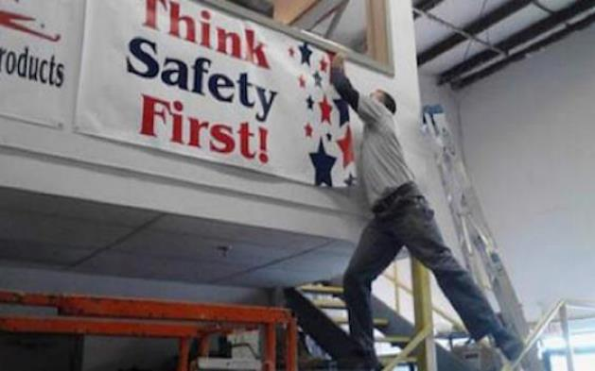
IND Safety Reporting is a “failed system” *
Lack of Global Harmonization
3 out of 5 countries have unique rules
Indeterminate Causality
47% reduction in US SUSARs
Fear of Regulatory Repercussion
20% of Sites refused to process SUSARs
* CTTI IND Safety Advancement Project Investigator Survey 2015
Notes:
IND Safety Reporting is a “failed system”. Again, not me saying that. This time, it’s the CTII Survey of PIs.
3 out of every 5 countries have a unique set of laws, different from any other countries.
News Flash – not every country is the same as the US. In fact no other country is like US.
Of the remaining countries, half of those are only the same as 1 other country e.g. Turkmenistan and Kyrgyzstan. That’s a pair.
Until you deeply analyze the rules, you have no idea of how much local disparity there is. I thought it was Europe, US and Japan had their own rules and that was it.
Problems deterning Causality: Roche has a 47% drop in US SUSARs after adopting a process that supported Sponsor Causality specific reporting. Other companies have seen an 80% or more difference.
Regulatory: Over-distribution is not the same as being compliant. All those over-distributed documents have to be tracked. Investigators in Australia, UK, Ireland etc. – all of whom don’t have to get 15 day SUSARs are pushing back. Investigators in US who don’t have to get Investigator Causality SUSARs are pushing back. Over-distribution becomes a huge risk to your approval as safety signals are missed.

Slide 10
The Solution

Slide 11

Making the Complex feel Simple
Realizing Local Country Laws will never harmonize
Roche created their own process and system
Configuration of business rules must be ‘simple’ process that doesn’t need IT or coding skills.
Business users must be able to set up the rules.
Notes:
ICH has been working on harmonizing rules for over 20 years with only isolated successes. So waiting for projects like EudraVigilance or Transcelerate to solve the problem is not an option. Local interpretation of laws will continue to differ.
Artificial intelligence. Machine Learning. IT setting up 1000s of rules and workflows. This is the new PV and Drug Safety IT religion. It has its place in surveillance. But in general the more complex a system is, the harder it is to understand, the less eyes are on it, the more likely it is to fail.
Therefore a central tenet of our implementation was that Business users would control the entire process. Every rule would be entered and maintained by the approved business expert using a wizard that someone with no IT experience could use.

Slide 12
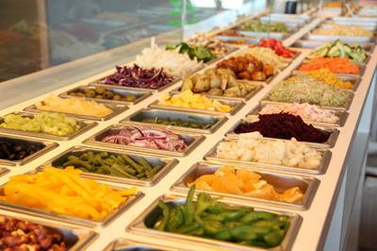
The Wrong Way – Take Whatever You Want
Allowing sites, CROs and ECs to set Preferences
Leads to Bad Behavior
Opting-out
Picking Wrong Options
e.g. Creamy Salad Dressing
Bacon Bits
Notes:
Our first attempt to design a system allowed every Sponsor, CRO, Site, and EC to set their own preferences. This turned out to be the wrong approach.
We use the salad bar metaphor to explain what went wrong.
Read slide.
People opted out and just skipped the Salad Bar and went straight onto the Brazilian steak house menu. Or people used the salad bar but picked the wrong things. You know eating salad without really eating salad.

Slide 13
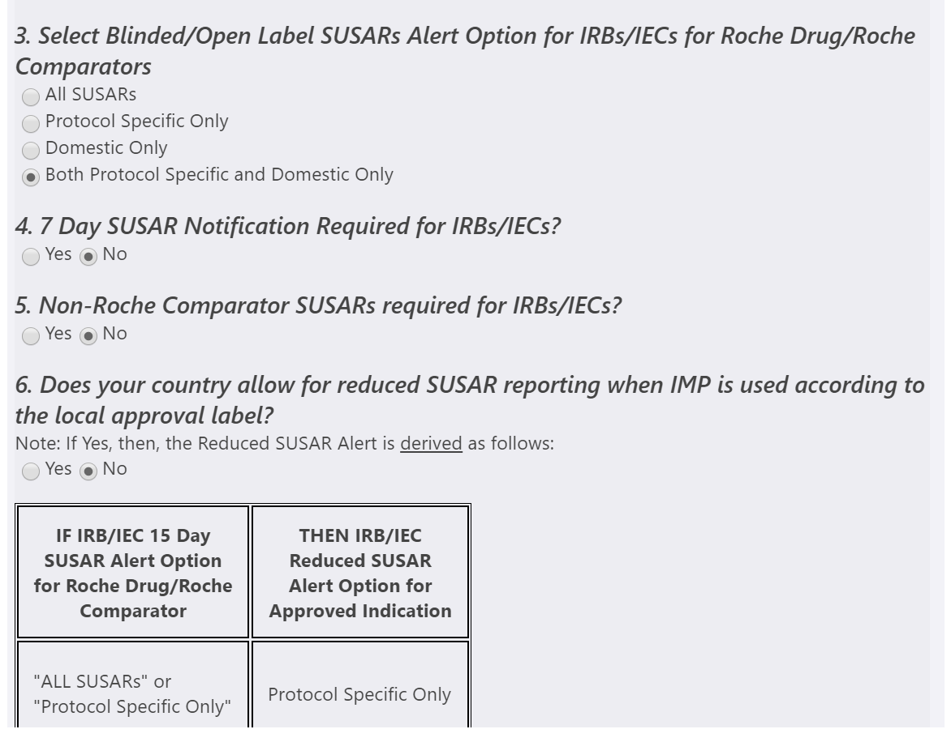
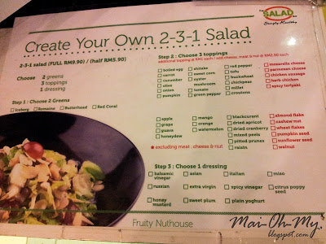
The Right Way – Picking off The Set Menu
Find the patterns in each country’s regulations
Central Safety Profile with Local Options for Countries to Choose
3% Exception Rate
Notes:
The right way. Have you ever been into a 2-3-1 Salad?
3% Exception

Slide 14
Clinical Trial Safety Portal
Availability
All internationally recognized safety documents for IMP compounds for Investigators and IRB/IECs on Interventional Studies
Standardization & Transparency
Alerting Options are set globally
Customization & Flexibility
Each country defines country alerting rules from the global alerting options
Investigator & Ethics Committee
Alerted that new safety documents are available based on the country alerting rules.
Can receive “all alerts” if required.
All safety documents available in system
Notes:
Read slide

Slide 15
Roche before CTSP
Over-Distribution
Fragmented Process
Resources
Multiple Interpretations of local law
Study Level Distribution
Sites/IRB/IECs
Study Teams
Monitors
Lack of Global Harmonization
Unclear rules
Accountabilities
Consistency and Application
Quality Oversight
Accountabilities
Fragmented Process
Compliance
Notes:
Read slides

Slide 16
Roche after CTSP
Global Process
Single end to end process
All studies, countries and partners
Compound Level Distribution
1 Safety document per recipient – for all studies
Aligned Global vs Local Law
Global Standards
Safety Document Characteristics
Country Rules
Direct Distributions to the Principal Investigator
Relevant safety details up front
Training
All information is available
Notes:
Read slides

Slide 17

Mistakes We Made
“Just ask the affiliates.
They know what they need”
Raw Intelligence is not operationalizable
Needed rigorous guidelines to collect Country Rules to avoid “we’ve always done it this way” syndrome
Retrain CROs, Sites, ECs and Internal Staff on new processes or you won’t realize the benefits
Notes:
Read slide
Emphasize the important of a structured process for collecting country rules.

Slide 18
What can you do to take action now?
Acknowledge you have a problem
Own it – Drug Safety/Clinical Operations
It feels Overwhelming but is Solvable
Follow Roche’s Process
If we can, so can you
Notes:
Read slide
Push Drug Safety to own the issue of making sure all Investigators and ECs are notified
Tell Hipaa Joke
A covered entity walks into a bar and says to the barman ‘I have this great Hipaa joke to tell you … except I can’t, because, you know, Hipaa

Slide 19
Q & A Session
Speaker
Steven Beales
sbeales@epharmaolutions.com
610-834-6209
https://www.linkedin.com/in/stevenbeales/
@stevenbeales

